Slide 1
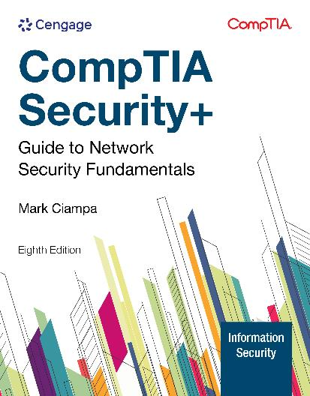
CompTIA Security+ Guide to Network Security Fundamentals, 8e
Add Image here
Module 1: Introduction to Information Security
Mark Ciampa, CompTIA Security+ Guide to Network Security Fundamentals, 8th Edition. © 2025 Cengage. All Rights Reserved. May not be scanned, copied or duplicated, or posted to a publicly accessible website, in whole or in part.

Slide 2
Icebreaker: Interview Simulation
The class will be broken up into pairs of students.
Each pair of students will interview each other to discover interesting or unusual facts.
Then, each pair will introduce each other to the class.
Think about connecting a story from your personal experiences to topics that are relevant to this course.

Slide 3
Module Objectives
By the end of this module, you should be able to:
Define information security and explain its principles
Identify threat actors and their motivations
Describe how attacks occur and the impact of attacks
List various information security resources

Slide 4
Understanding Security (1 of 2)
Security is the state of being free from danger, which is the goal of security
It is also defined as the “measures taken to ensure safety”, which is the process of security
As security is increased, convenience is often decreased
The more secure something is, the less convenient it may become to use

Slide 5
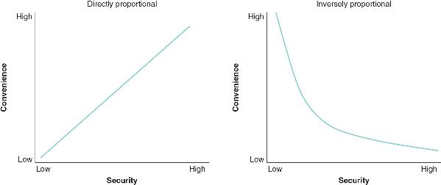
Understanding Security (2 of 2)
Figure 1-1 Relationship of security to convenience

Slide 6
Principles of Security (1 of 3)
The following are three types of security protections (CIA):
Confidentiality ensures that only approved individuals may access information
Integrity ensures that information is correct and unaltered
Availability ensures that information is accessible to authorized users

Slide 7
Principles of Security (2 of 3)
Another security principle involves controlling access to information and involves authentication, authorization, and accounting
Authentication is the act of ensuring a user’s credentials as authentic
Authorization grants permission for a user to take a particular action
Accounting creates a record that is preserved of who accessed the network, what resources they accessed, and when they disconnected from the network

Slide 8
Principles of Security (3 of 3)
A security control is a safeguard that is employed within an enterprise to protect the CIA of information and can include the following:
Deterrent controls
Preventive controls
Detective controls
Compensating controls
Corrective controls
Directive controls

Slide 9
Cybersecurity versus Information Security
Cybersecurity usually involves a range of practices, processes, and technologies intended to protect devices, networks, and programs that process and store data in an electronic form
Information security protects “processed data” that is essential in an enterprise environment

Slide 10
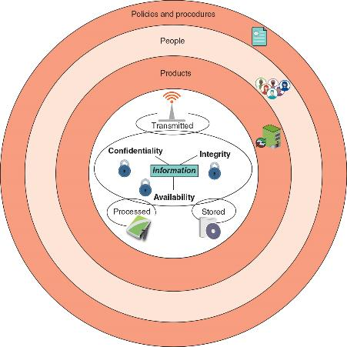
Defining Information Security
Figure 1-2 Information security layers

Slide 11
Knowledge Check Activity 1-1
Serafina is studying to take the Security+ certification exam. Which of the following of the CIA elements ensures that only authorized parties can view protected information?
A. Confidentiality
B. Integrity
C. Availability
D. Credentiality

Slide 12
Knowledge Check Activity 1-1: Answer
Serafina is studying to take the Security+ certification exam. Which of the following of the CIA elements ensures that only authorized parties can view protected information?
Answer: A. Confidentiality
Explanation: Confidentiality ensures that only authorized parties can view the information. Providing confidentiality can involve several different security tools, ranging from software to encrypt the credit card number stored on the web server to door locks to prevent access to those servers.

Slide 13
Threat Actors and Their Motivations
A threat actor is an individual or entity responsible for attacks
The generic term attacker is also commonly used
Financial crime is often divided into three categories based on targets:
Individual users
Enterprises
Governments
Threat actors can be categorized as unskilled attackers, shadow IT, organized crime, insiders, hacktivists, nation-state actors, and others

Slide 14
Unskilled Attackers
Individuals who want to perform attacks yet lack the technical knowledge to carry them out are sometimes called unskilled attackers
Easy-to-use attacks tools are freely available or can be purchased at a low cost to perform sophisticated attacks
Unskilled attackers use these types of tools to carry out their attacks
Their motivation is usually data exfiltration or service disruption

Slide 15
Shadow IT
The process of bypassing corporate approval for technology purchases is known as shadow IT
The employee’s motivation is often ethical, but it often weakens security

Slide 16
Organized Crime
Organized crime is a close-knit group of highly-centralized enterprises set up for the purpose of engaging in illegal activities
In recent years, organized crime has moved into cyberattacks
They consider this to be less risky and more rewarding than traditional crime
The motivation is generally financial gain

Slide 17
Insider Threats
Another threat comes from a company’s own employees, contractors, and business partners, called insiders
Motivation could be revenge or blackmail
Attacks from insider threats are hard to recognize

Slide 18
Hacktivists
Groups or individuals that are strongly motivated by ideology (for the sake of their principles or beliefs) are hacktivists
The types of attacks by hacktivists often involve breaking into a website and changing its contents as a means of a political statement
Other attacks are retaliatory:
Hacktivists have disabled a bank’s website that didn’t allow online payments deposited into accounts belonging to groups supported by hacktivists
The motivation is to cause disruption/chaos

Slide 19
Nation-State Actors
Governments are increasingly employing their own state-sponsored attackers for launching cyberattacks against their foes
These attackers are known as nation-state actors
Nation-state actors are often involved in multiyear intrusion campaigns targeting highly sensitive economic, proprietary, or national security information
A new class of attacks called advanced persistent threat (APT) use innovative attack tools that silently extract data over an extended period of time

Slide 20
Other Threat Actors
Threat actor | Description | Explanation
Competitors | Launch attack against an opponent’s system to steal classified information | Competitors may steal new product research or a list of current customers to gain a competitive advantage
Brokers | Sell their knowledge of a weakness to other attackers or governments | Individuals who uncover weaknesses do not report them to the software vendor but instead sell them to the highest bidder, who are willing to pay a high price for the unknown weakness
Cyberterrorists | Attack a nation’s network and computer infrastructure to cause disruption and panic among citizens | Targets may include a small group of computers or networks that can affect the largest number of users, such as the computers that control the electrical power grid of a state or region

Slide 21
Knowledge Check Activity 1-2
What is considered the motivation of an employee who practices shadow IT?
A. Deception
B. Ignorance
C. Ethical
D. Malicious

Slide 22
Knowledge Check Activity 1-2: Answer
What is considered the motivation of an employee who practices shadow IT?
Answer: C. Ethical
Explanation: The process of bypassing corporate approval for technology purchases is known as shadow IT. The employee’s motivation is often ethical (it has sound moral principles) but nevertheless weakens security.

Slide 23
Threat Vectors and Attack Surfaces (1 of 3)
An attack surface (threat vector) is a digital platform that threat actors target for their exploits
Some attack surfaces can be considered mainstream for several reasons:
They have been the primary targets of threat actors
These attack surfaces are found in all technology settings
They continue to bear the brunt of attacks today

Slide 24
Threat Vectors and Attack Surfaces (2 of 3)
Other threat vectors are more specialized and can be divided into categories such as communications and supply chain
The most common communication tools are message-based and include email, texts, instant messages, and voice calls
A supply chain is a network that moves a product from its creation to the end-user
Each link in a supply chain can be a potential threat vector
Malware can be injected into a product during its manufacturing, storage, and distribution (called supply chain infections)

Slide 25
Threat Vectors and Attack Surfaces (3 of 3)
Software supply chains have recently been the target of attackers
An alarming type of supply chain infection targets open-source software, which is software where the source code is available for anyone to freely use without restrictions
Threat actors add their malicious code to an open-source project, which is then downloaded and installed by unsuspecting victims

Slide 26
Categories of Vulnerabilities (1 of 3)
A vulnerability is the state of being exposed to the possibility of being attacked or harmed
Cybersecurity vulnerabilities can be categorized into software, hardware, misconfigurations, and zero-day vulnerabilities
Software
Vulnerabilities are predominately found in software, with OS software being the chief culprit
Attacks may include a malicious update

Slide 27
Categories of Vulnerabilities (2 of 3)
Hardware
The following hardware vulnerabilities can lead to a successful attack:
Difficulty patching firmware, legacy platforms, and end-of-life (EOL) hardware
Misconfigurations
Often configuration settings are not properly implemented, resulting in misconfigurations that can then result in vulnerabilities

Slide 28
Categories of Vulnerabilities (3 of 3)
Zero-day vulnerabilities
Vulnerabilities can be exploited by attackers before anyone else even knows it exists
This type of vulnerability is called a zero-day because it provides zero days of warning
Zero-day vulnerabilities are considered extremely serious

Slide 29
Impacts of Attacks (1 of 2)
A successful attack always results in several negative impacts
These impacts can be classified as the following:
Data impacts (see Table 1-8 on the following slide)
Overall effects
The attack may make systems inaccessible (availability loss), which results in lost productivity (financial loss)
Attacks may affect the public perception of the enterprise (reputation)

Slide 30
Impacts of Attacks (2 of 2)
Impact | Description | Example
Data loss | The destruction of data so that it cannot be recovered | Maliciously erasing patient data used for cancer research
Data exfiltration | Stealing data to distribute it to other parties | Taking a list of current customers and selling it to a competitor
Data breach | Stealing data to disclose it in an unauthorized fashion | Theft of credit card numbers to sell to other threat actors
Identity theft | Taking personally identifiable information to impersonate someone | Stealing a Social Security number to secure a bank loan in the victim’s name

Slide 31
Information Security Resources
Defenders have the following external cybersecurity resources to help ward off attacks:
Frameworks
Regulations
Legislation
Standards
Benchmarks/secure configuration guides
Information sources

Slide 32
Frameworks (1 of 2)
An information security framework is a series of documented processes used to define policies and procedures for implementation and management of security controls in an enterprise environment
The National Institute of Standards and Technology (NIST) frameworks are divided into three basic parts:
Framework core
Implementation tiers
Profiles

Slide 33
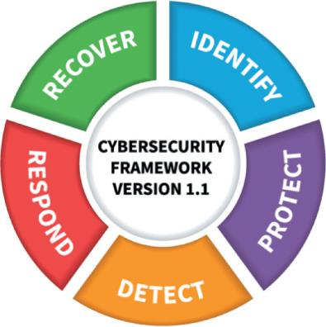
Frameworks (2 of 2)
Figure 1-5 NIST Cybersecurity Framework (CSF) functions

Slide 34
Regulations
The process of adhering to regulations is called regulatory compliance
Most organizations must follow multiple regulations from different regulatory bodies
For information security, there are the following:
Broadly applicable regulations
Industry-specific-regulations
U.S. state regulations
International regulations

Slide 35
Legislation
Specific legislation or laws can be enacted by governing bodies that can provide an information security resource
These include national, territorial, and state laws
With the number of different entities involved in passing multiple legislation, this often leads to a “hodge-podge” of legislation and is not always a good cybersecurity resource

Slide 36
Standards
A standard is a document approved through consensus by a recognized standardization body
It provides for frameworks, rules, guidelines, or characteristics for products or related processes and production methods
One information security compliance standard is the Payment Card Industry Data Security Standard (PCI DSS)

Slide 37
Benchmarks/Secure Configuration Guides
Benchmarks/secure configuration guides are usually distributed by hardware manufacturers and software developers
They serve as a guideline for configuring a device or software so that it is resilient to attacks
Usually these are platform-/vendor-specific guides that only apply to specific products

Slide 38
Information Sources
Requests for comments (RFCs) are document “white papers” that are authored by technology bodies employing specialists, engineers, and scientists who are experts in those areas
Data feeds are continually maintained databases of the latest cybersecurity incidences
Common cybersecurity data feeds include vulnerability feeds that provide information on the latest vulnerabilities
The adversary tactics, techniques, and procedures (TTP) is a database of the behavior of threat actors and how they manage attacks

Slide 39
Knowledge Check Activity 1-3
What is another name for “attack surface”?
A. Vulnerability exposure
B. Threat vector
C. Legacy platform
D. Attack floor

Slide 40
Knowledge Check Activity 1-3: Answer
What is another name for “attack surface”?
Answer: B. Threat vector
Explanation: An attack surface, also called a threat vector, is a digital platform that threat actors target for their exploits.

Slide 41
Self Assessment
Rate your competence of the following module objectives on a scale of 1 to 5 where 5 indicates you have full confidence in your competence of that objective and 1 indicates you have very little confidence in your competence of that objective. If you self-score less than 4 you should consider reviewing the module and related exercises:
Define information security and explain its principles
Identify threat actors and their motivations
Describe how attacks occur and the impact of attacks
List various information security resources

Slide 42
Summary
Now that the lesson has ended, you should be able to:
Define information security and explain its principles
Identify threat actors and their motivations
Describe how attacks occur and the impact of attacks
List various information security resources

